Slide 1
INDEX App INDividualised EXercise approach for people with chronic low back pain (INDEX study): The development of an enhanced EMG biofeedback app
Carolina Costa Lopes
MSC student in advanced computer science: digital biology
Supervised by Dr Alex Casson and Dr Janet Deane
25.07.2022
Notes:
https://livewellwithpain.co.uk/resources/resources-for-your-patients/
https://www.britishpainsociety.org/people-with-pain/
From Elaine to Everyone 03:06 PM
👍
From Michelle Briggs to Everyone 03:07 PM
https://www.youtube.com/watch?v=C_3phB93rvI

Slide 2


Carolina
MSc Student at The University of Manchester in Advanced Computer Science: Digital Biology
BSc Computer Science from King’s College London
Notes:
Interested in how technology can be used to improve patient and clinicians experience and quality of life.

Slide 3
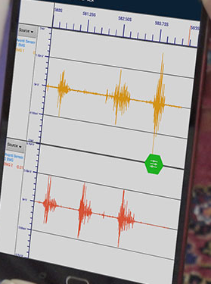
Aim
NHS suggests and promotes the use of self-management and exercise for low back pain
It is hard to determine the best way to exercise
The app would allow the user to see how much their muscles work during the exercise
The user can compare their muscle activity throughout their exercise session, and compare to previous sessions
Currently only EMG visualisation can be seen from sensors
Only understood by trained clinicians
We aim to:
Reduce pain
Improve quality of life
Help people understand their own bodies better
Make an app that can be accessible to all

Slide 4

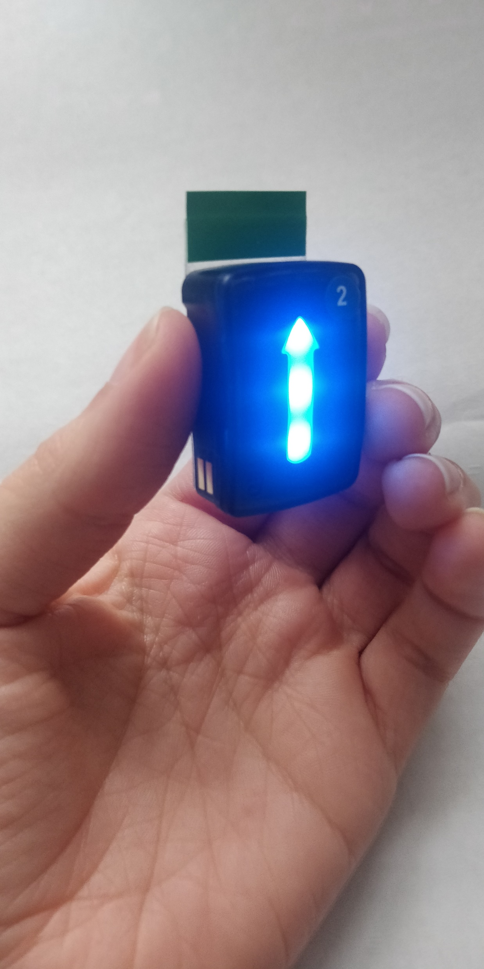
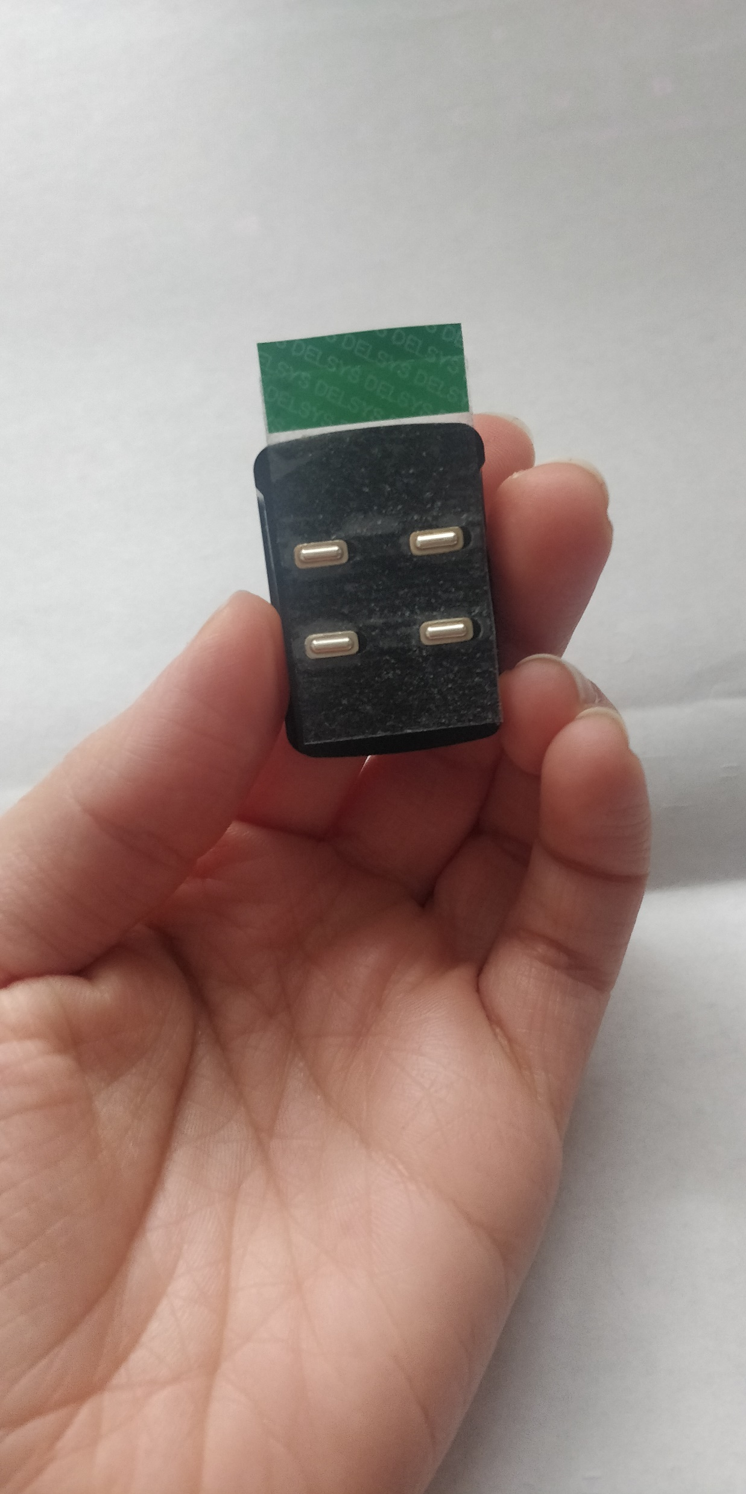
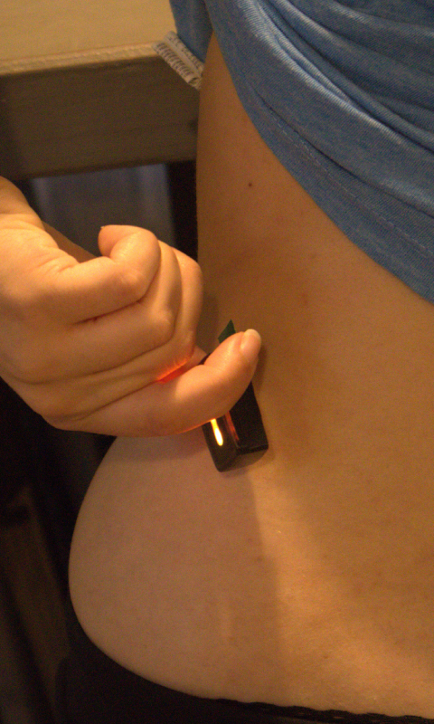
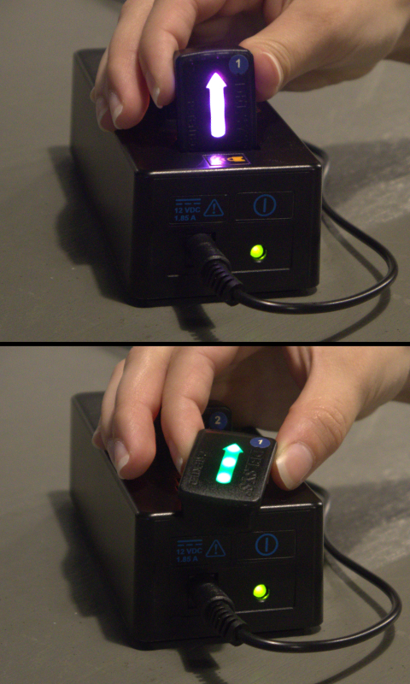
The sensors
Notes:
Small
Lightweight
2 sensors would be used

Slide 5
Journey so far

Slide 6
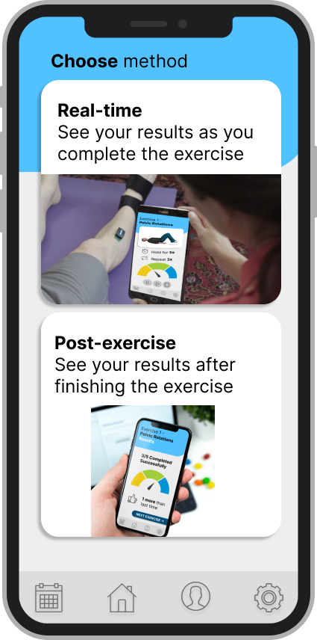
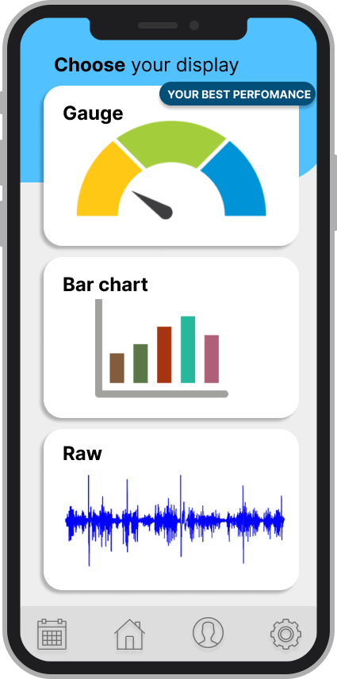
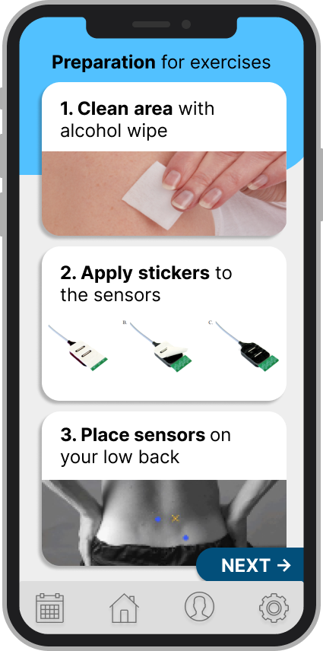
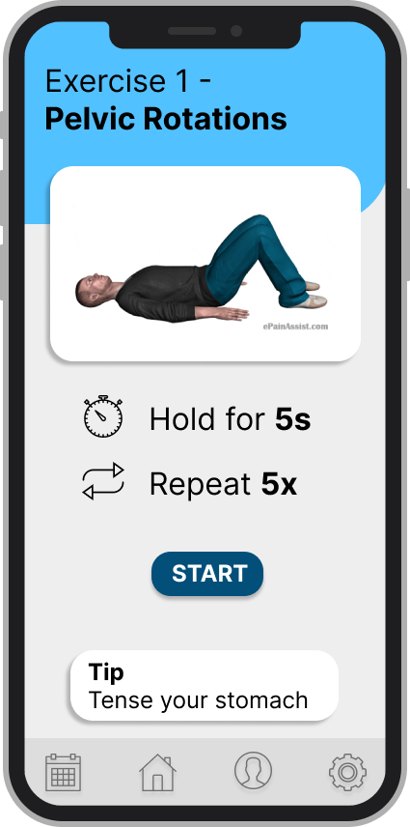
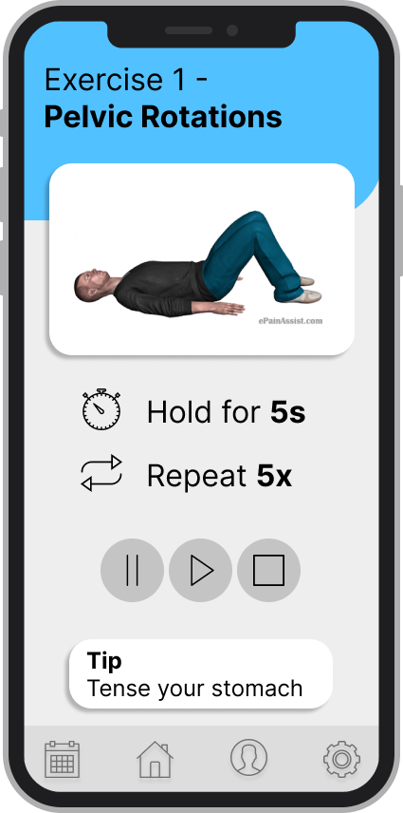
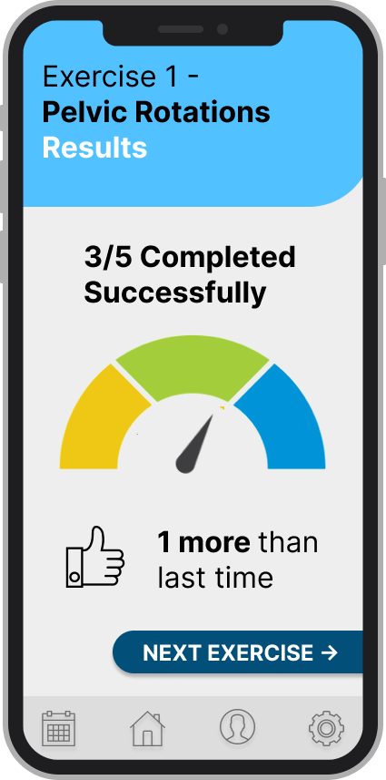
Previous MSK session
Initial session in May with 3 MSK members to discuss initial design ideas.
Designs shown:

Slide 7
Feedback received
Personalisation of the gifs as an option
Include different body shapes
Include different difficulties for the exercise
Encouraging notes and reminders
Can complete these exercises in other settings etc.
Visualisation of the results of the session with thumbs up/smileys/encouraging messages
Notes:
Many if not all the feedback given in the previous session is planned for the future but it is more advanced.

Slide 8
App development
Understand and connect the sensors
Learn how to make an app
Work on the designs of the application
Project Overview and Planning report was a success
Minimal viable product is ready!
Notes:
As with all projects, I have had to learn a lot of new skills, and worked with new technologies
As part of the msc project I also submitted a project overview and planning report which included background research, literature reviews, designs and methodologies and planning. It received a very good grade and feedback determining that the project is on a great path to success.
The first step in the project was to create a minimal viable product. This is what I will be showing you.

Slide 9
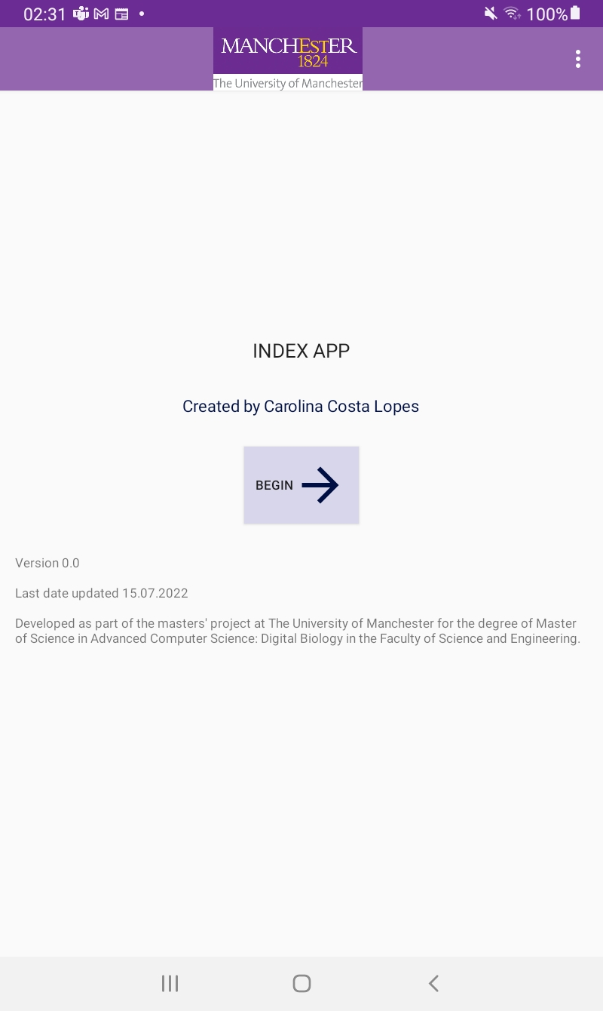
Minimal viable product
What would you like to see first when you open the application?
Straight into connecting the sensors?
Information about your last session?
Positive/motivational quote?
Other?
Notes:
These are screenshots of the app in order and with correct navigation. This is not the end product, there is a lot of work ahead, but I would love any feedback you have so that I can make the app as tailored to patient user experience as possible. Some pages of the app have specific questions, but please feel free to give feedback on any part of the application.

Slide 10
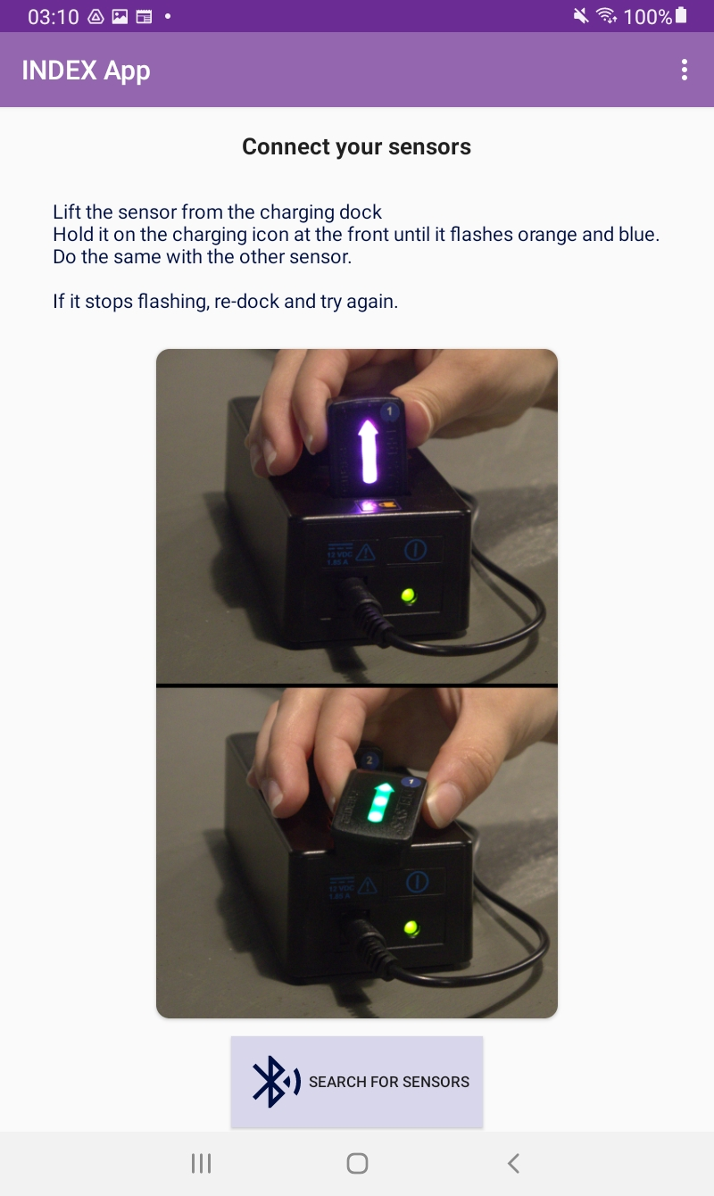
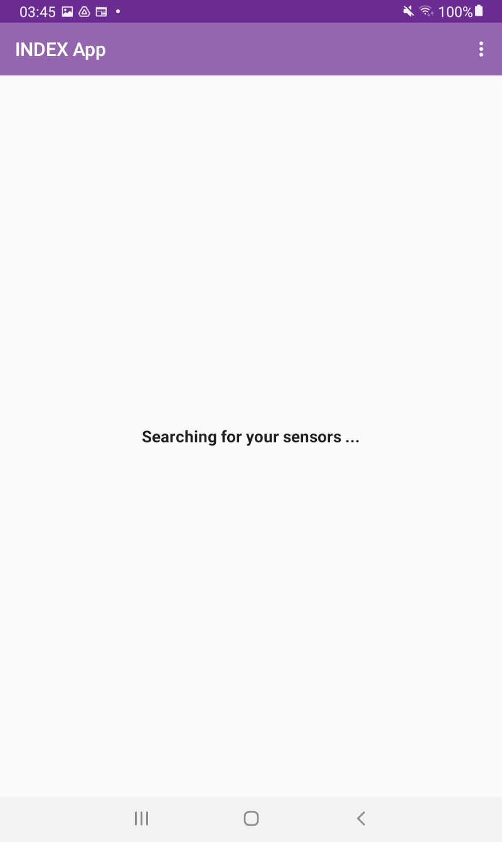
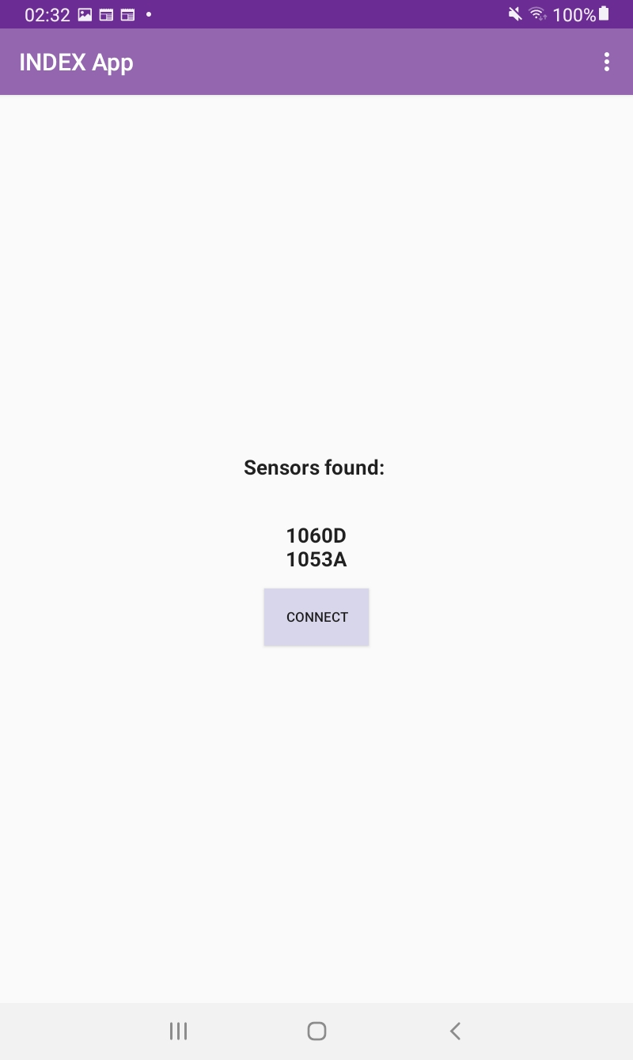

Slide 11
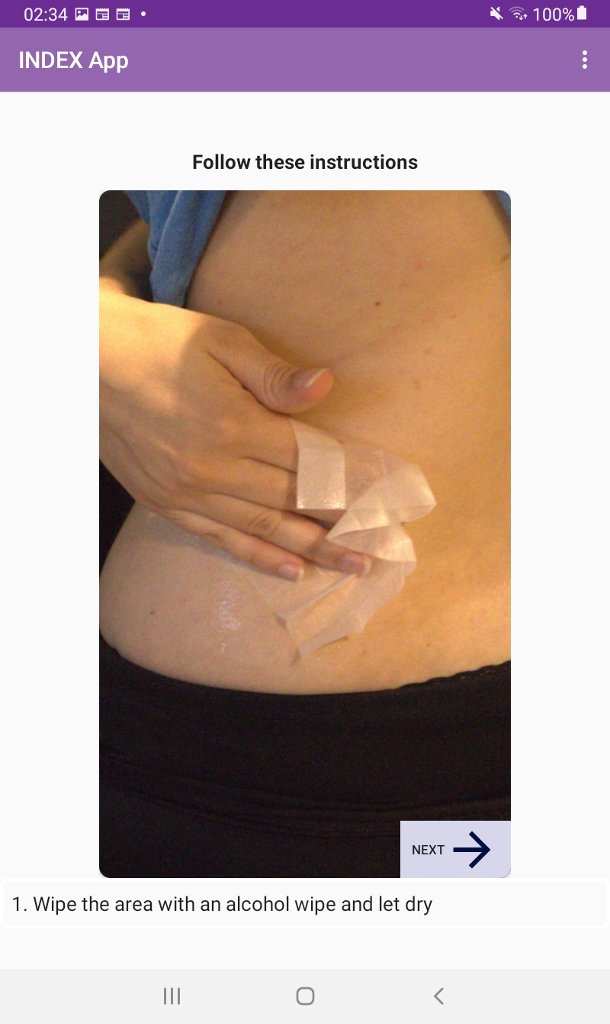
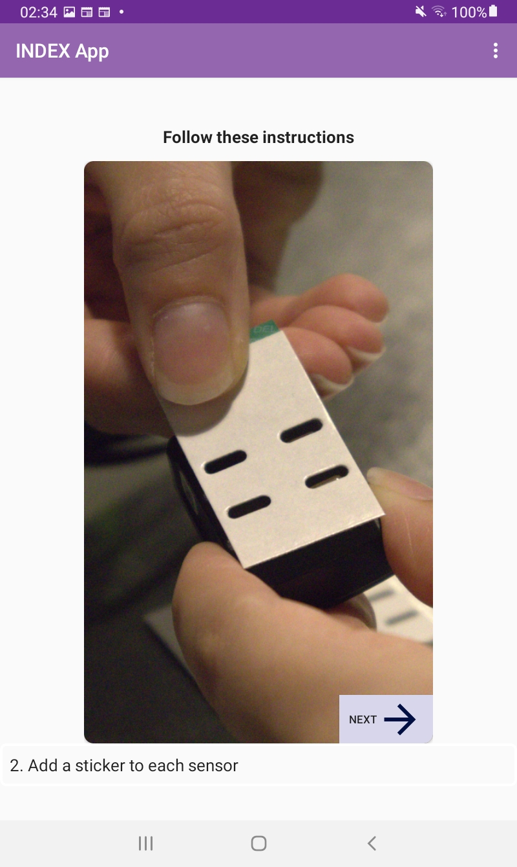
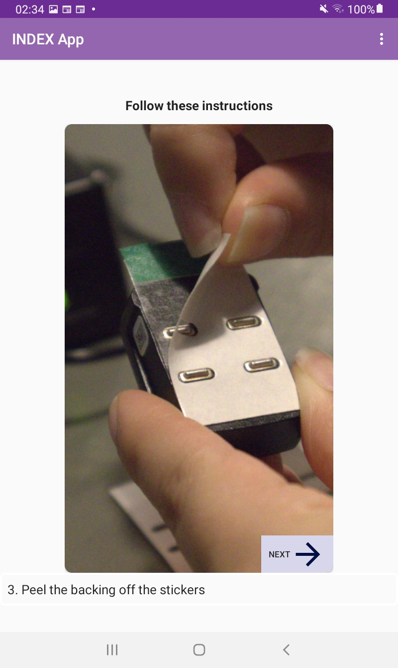
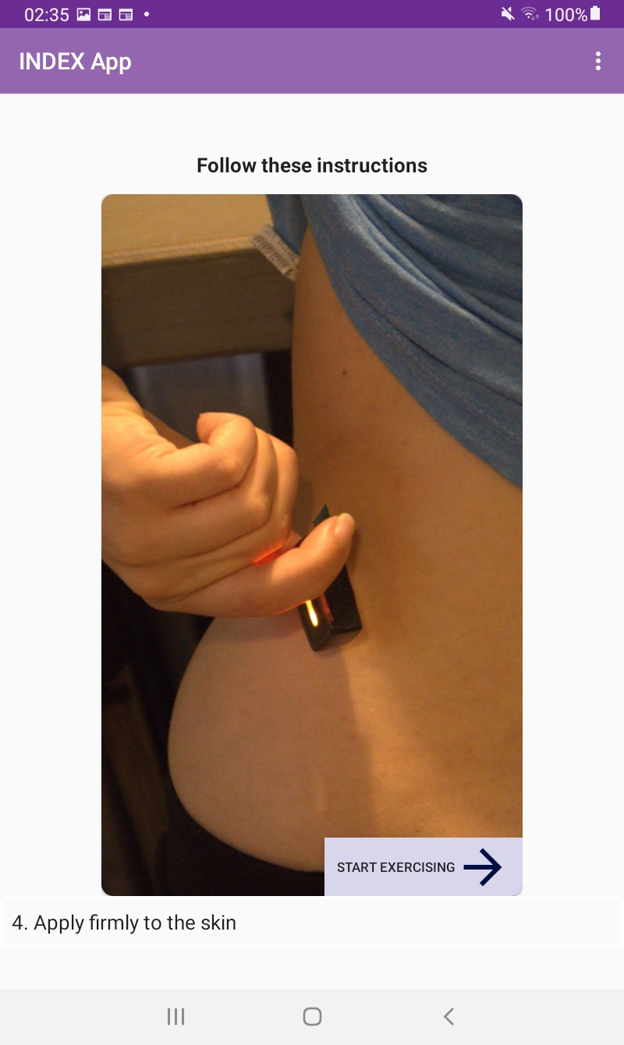

Slide 12
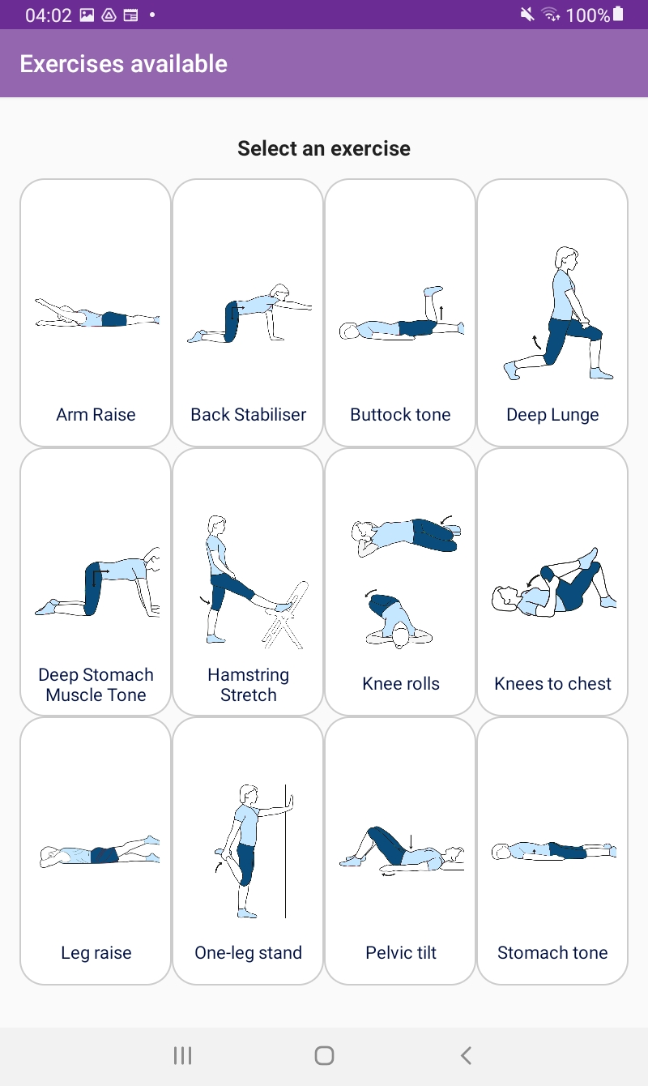
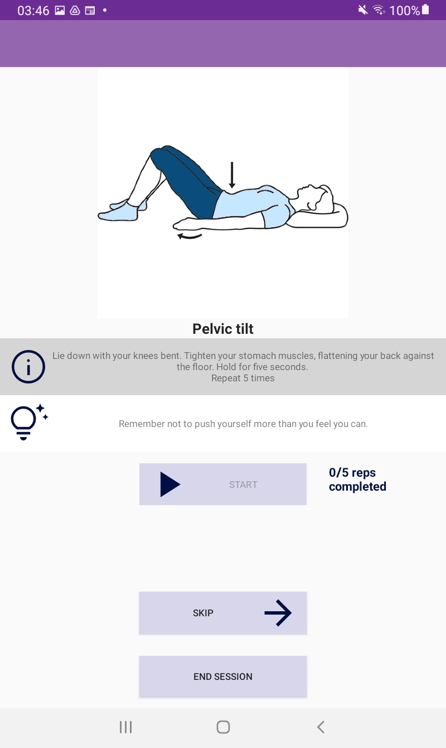
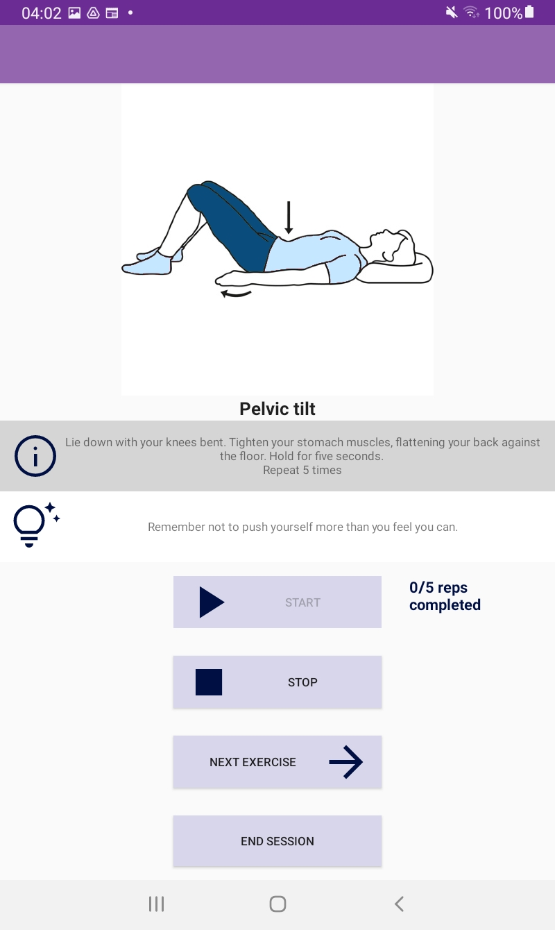

Slide 13
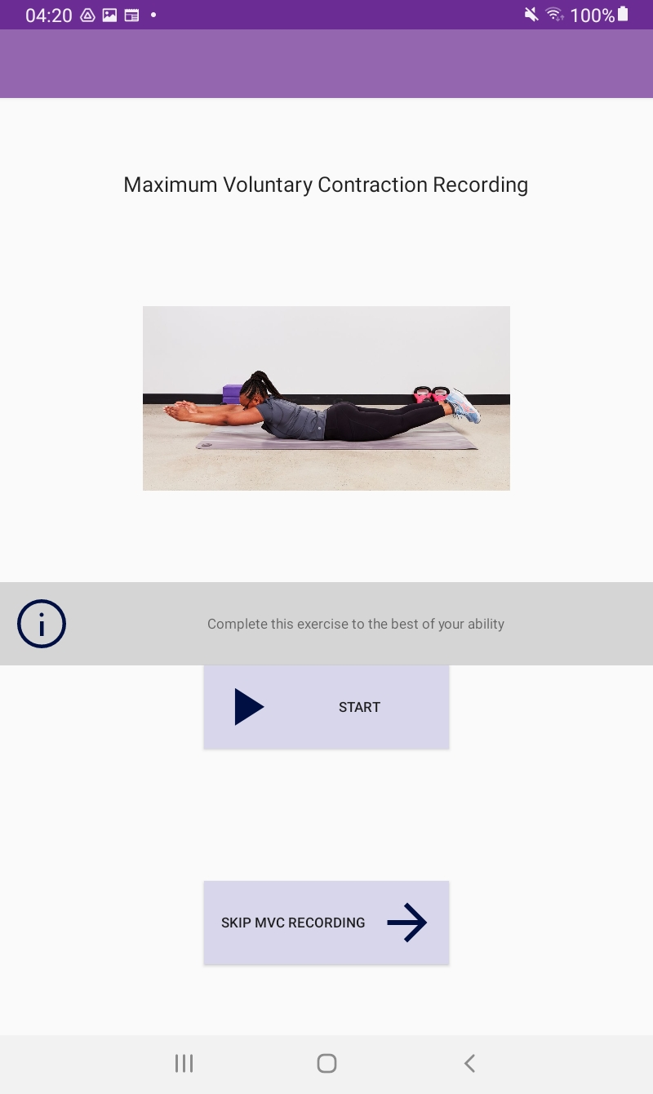
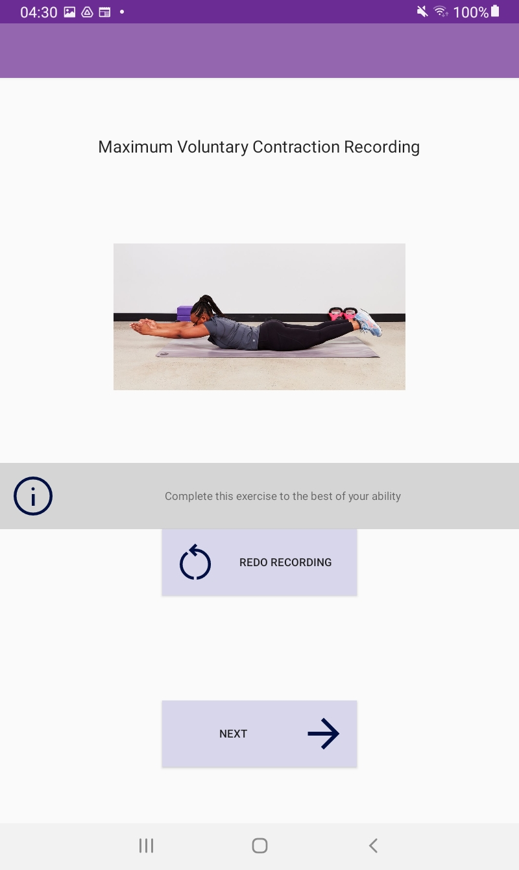
What would you think you need to do?

Slide 14
What would you think you need to do?
An MVC is an important recording needed for the calculations of how well the exercises were performed.

Slide 15
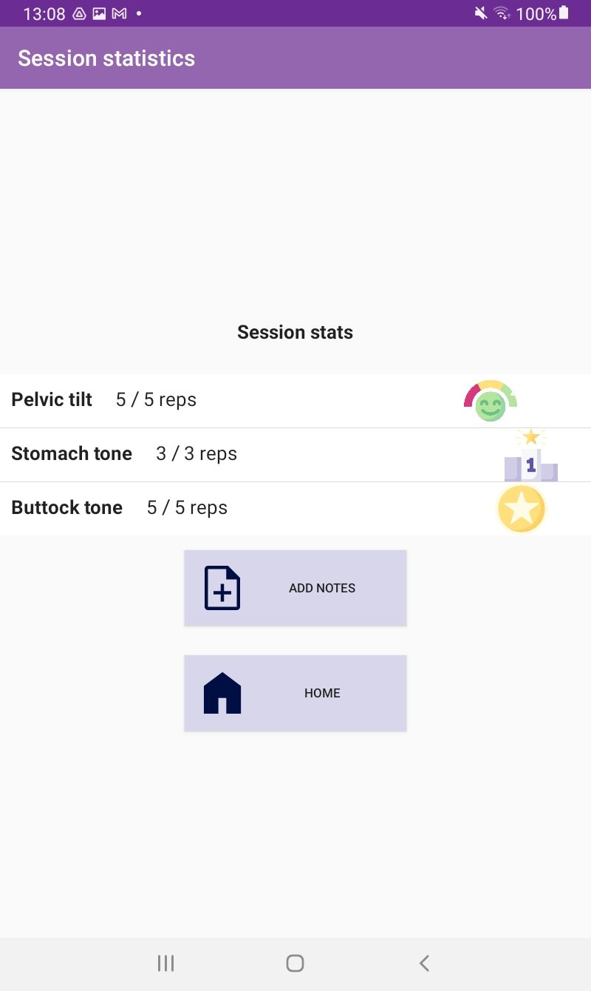
What kind of information would you like to see about your session?
Time it took?
Direct comparison to previous session?

Slide 16





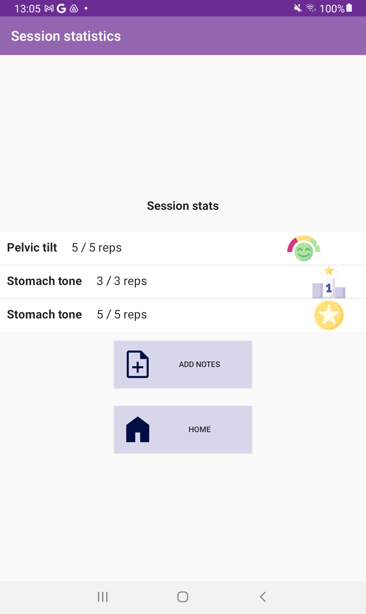



Options for performance display
You reached 100 % of your potential
You reached 80 % of your potential
You reached 80 %
of your potential

Slide 18
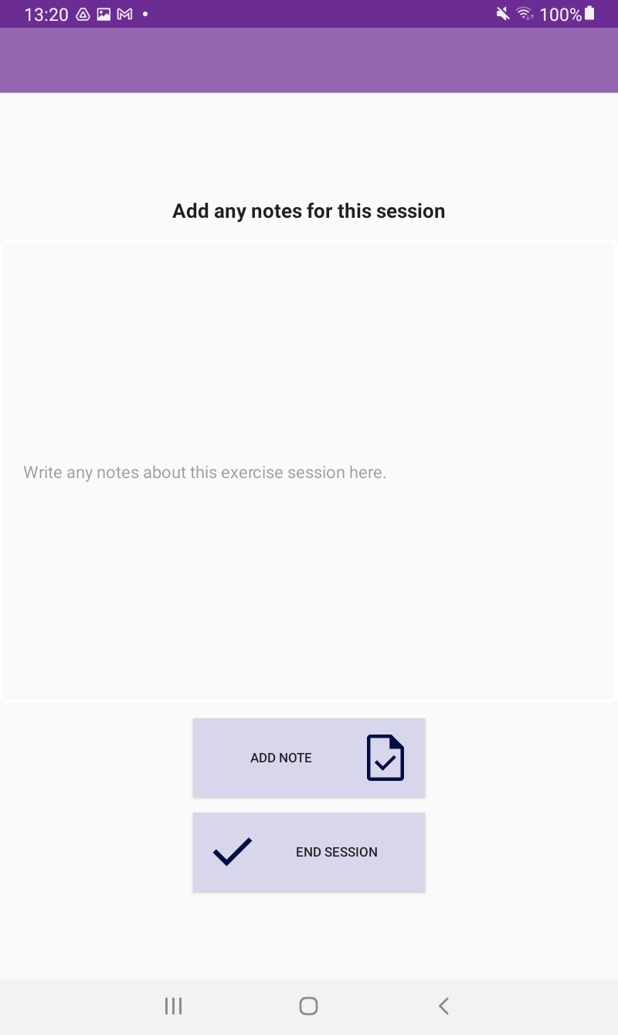
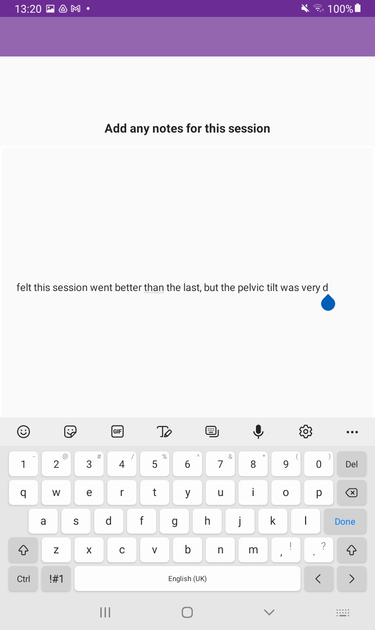
What kind of information would you like to include in notes?
Free text
Pain levels
Would a tick box quiz style be better?
Rating out of 5 for different aspects

Slide 19
Next steps
Visualisation during exercise
Different forms of visualisation
raw, gauge, threshold
Different levels of difficulty for the exercises
Easy, medium, difficult
Connection to the physiotherapist
Send notes or ask for adaptations to the set exercises
Testing and evaluation
Part of my project, this PPI also contributes to the evaluation of the application and the project
Notes:
Unfortunately, I won’t be able to complete a full app during my project since hand in is at the start of September. However, the project will hopefully be continued and developed further using all the feedback received from the previous session and this one.

Slide 20
THANK YOU

Slide 21
